Slide 1


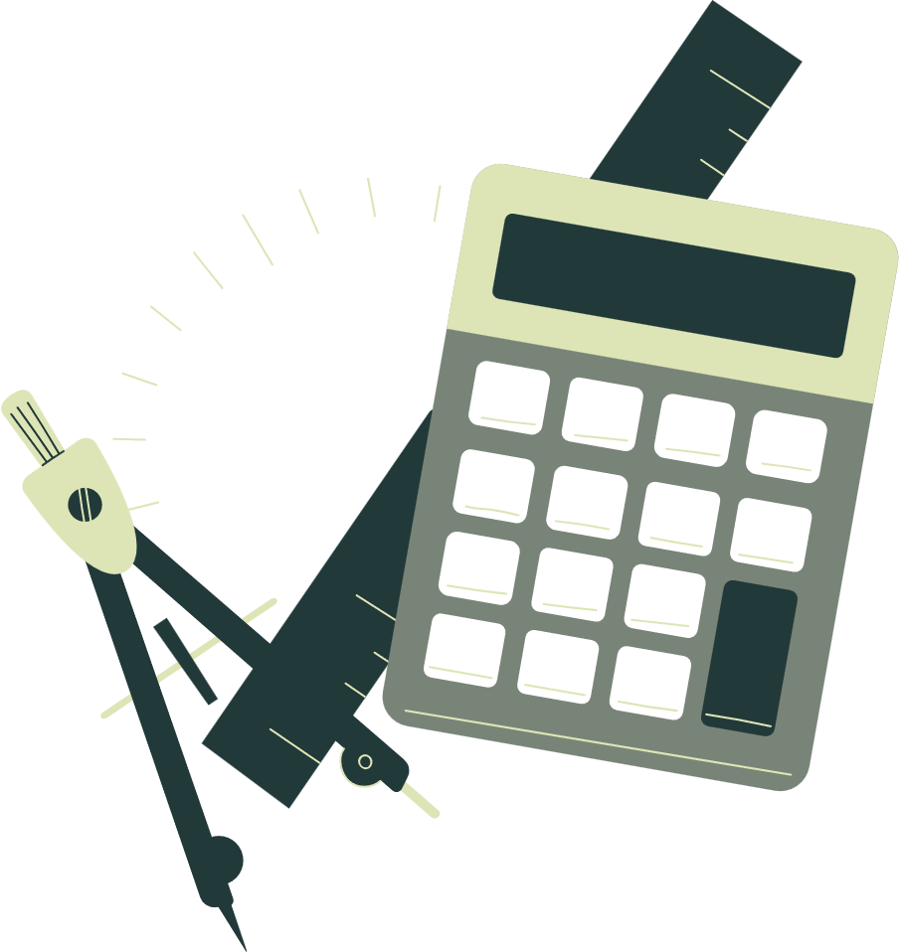


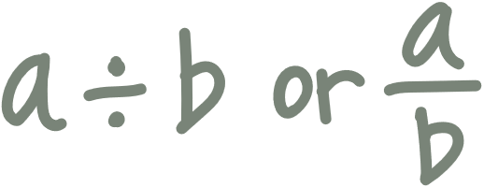
Welcome to our
MATHEMATICS
Class
Prepared by: Mr. Fajardo

Slide 2
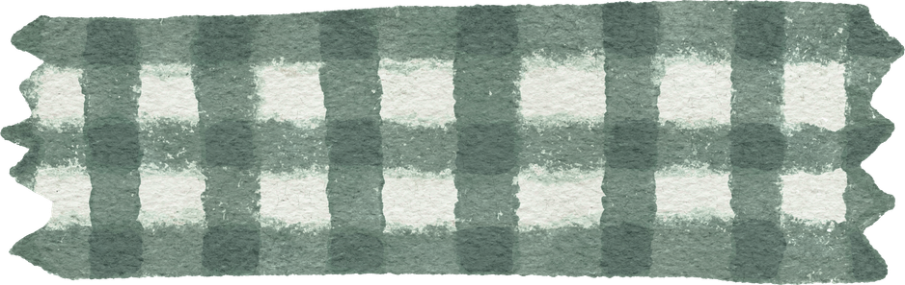
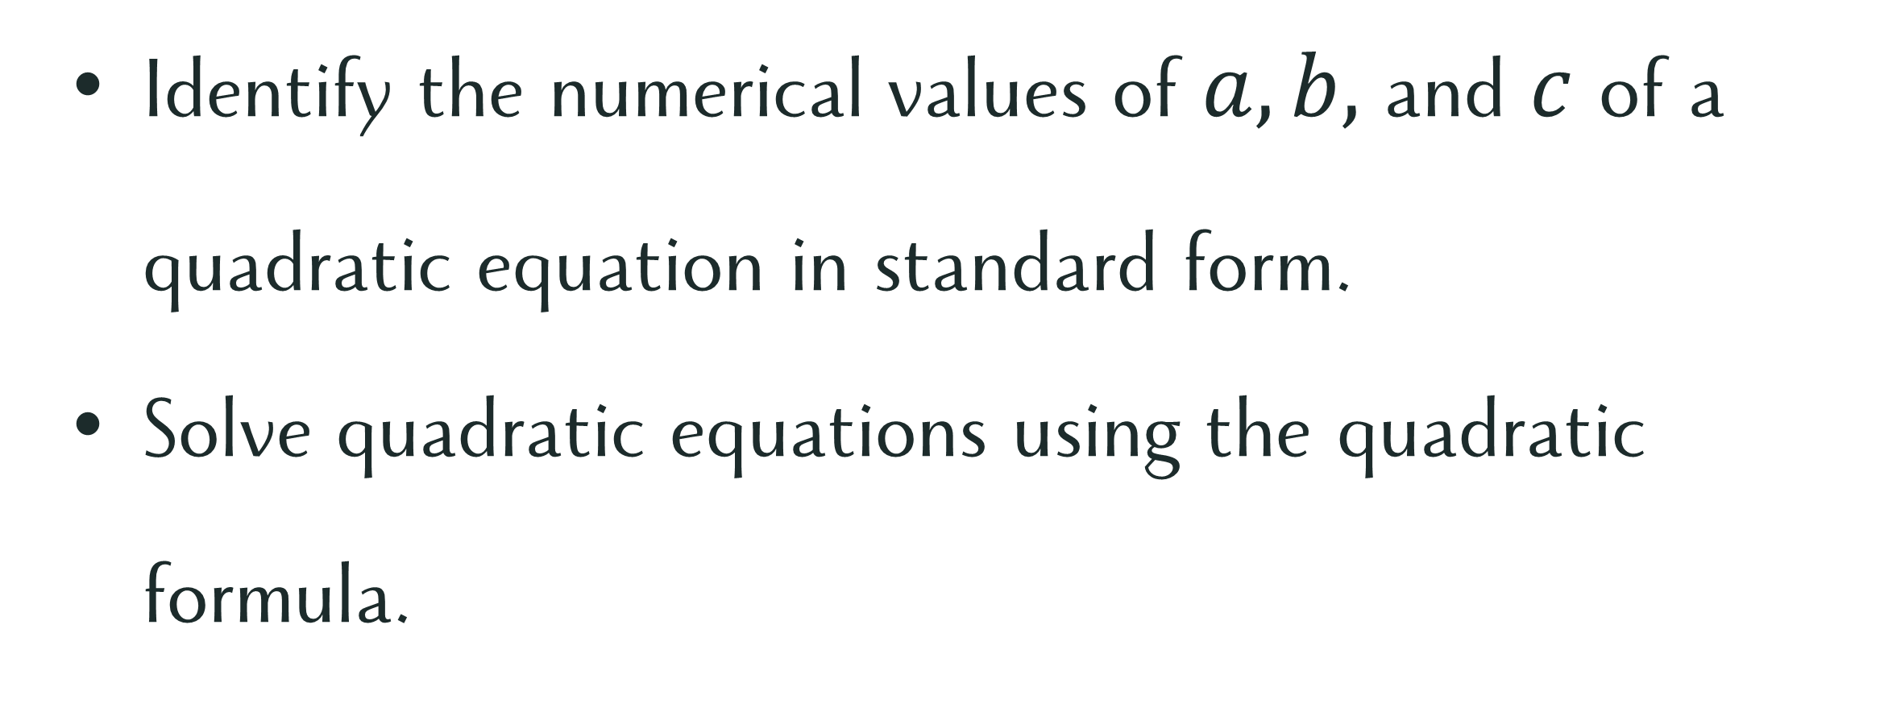
Learning Objectives
Identify the numerical values of $a, b,$ and $c$ of a quadratic equation in standard form.
Solve quadratic equations using the quadratic formula.

Slide 3
Exploration activity

Slide 4
Exploration activity
Consider the Scenario

Slide 5
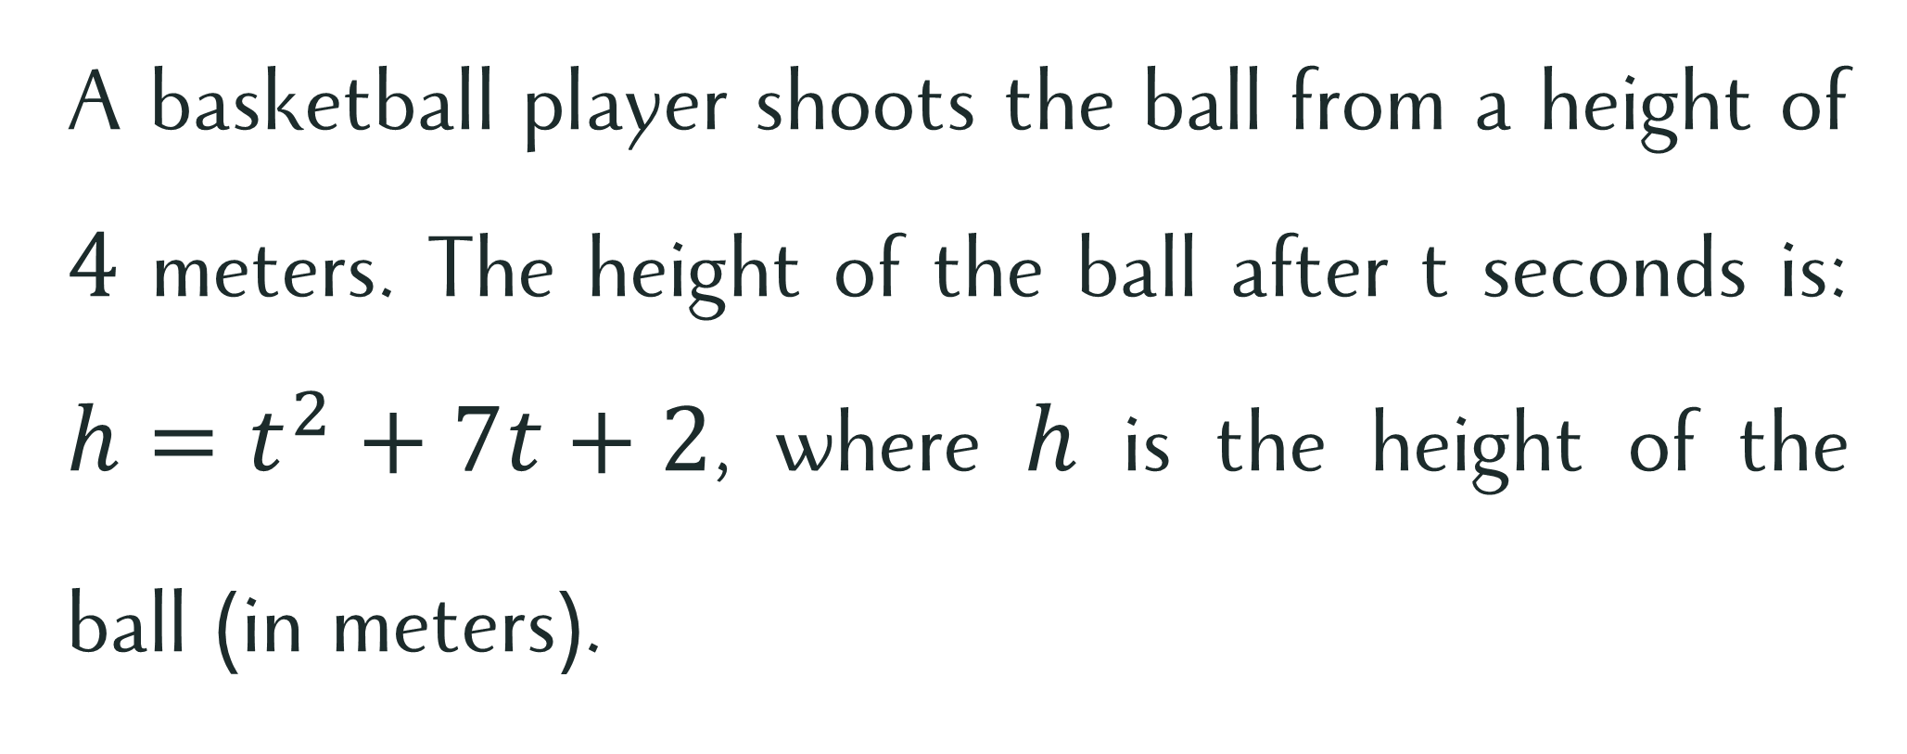
Exploration Activity
A basketball player shoots the ball from a height of $4$ meters. The height of the ball after t seconds is: $h=t^{2}+7t+2$, where $h$ is the height of the ball (in meters).

Slide 6
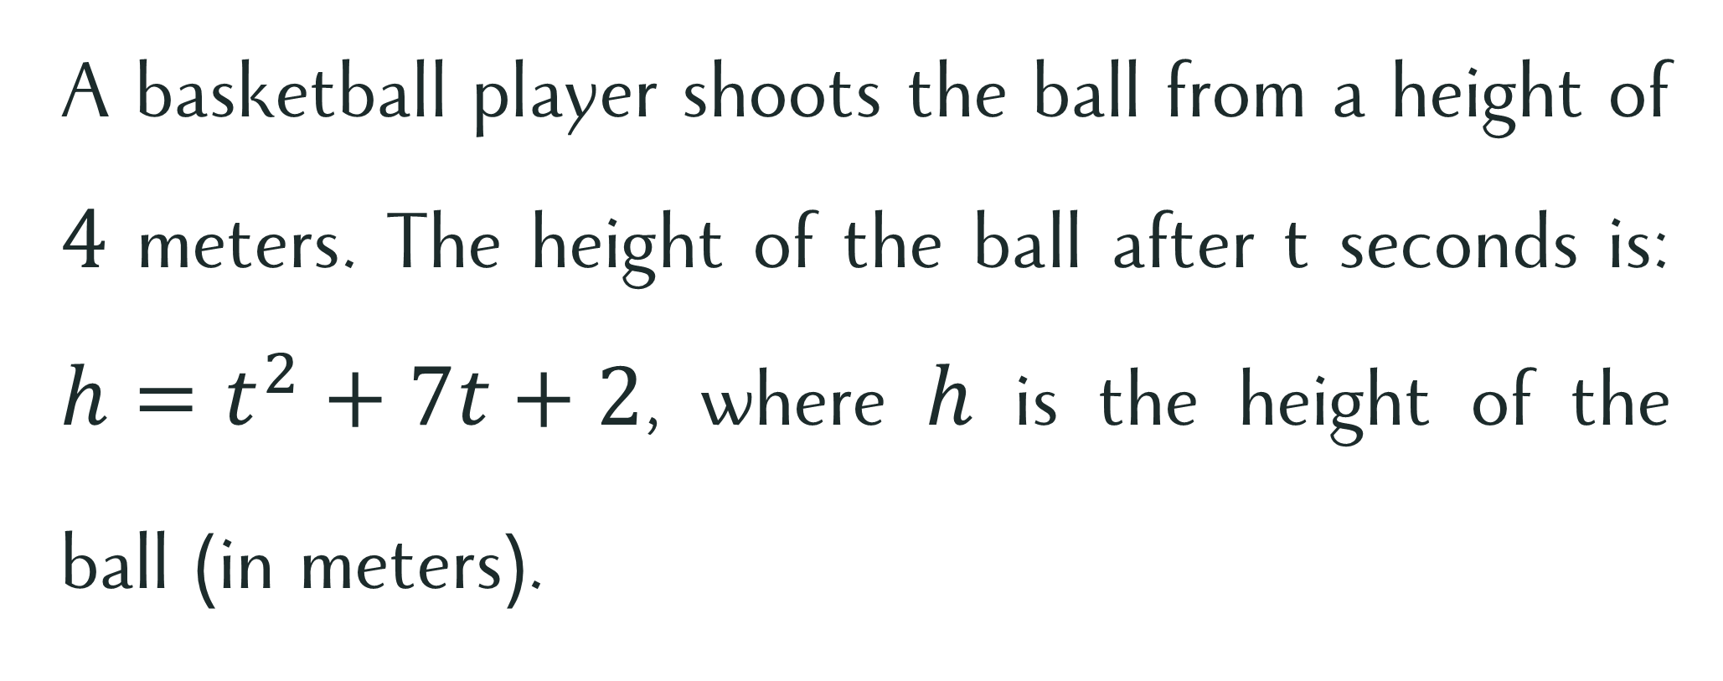
Exploration Activity
A basketball player shoots the ball from a height of $4$ meters. The height of the ball after t seconds is: $h=t^{2}+7t+2$, where $h$ is the height of the ball (in meters).
Is the equation easy to solve by the methods you learned previously?

Slide 7
Quick
recall

Slide 8

Quick
recall
Find the values of $a, b,$and $c.$

Slide 9


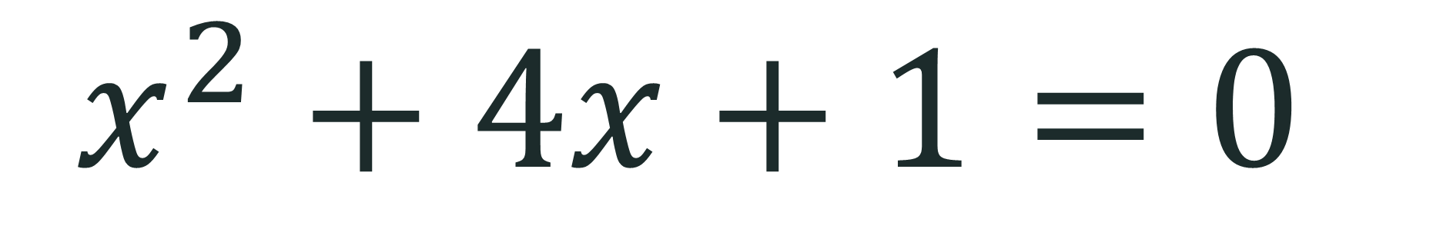
Find $a, b,$ and $c$.
$$x^{2}+4x+1=0$$
$$a=1, b=4, c=1$$

Slide 10

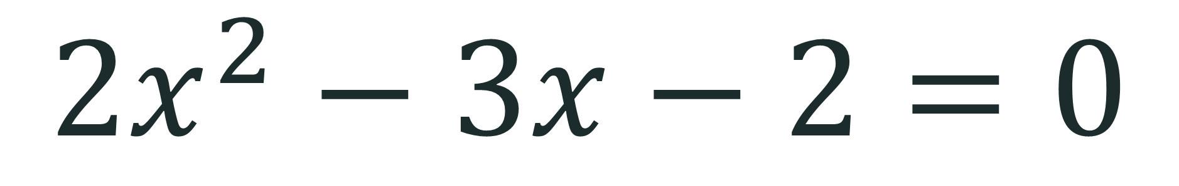
Find $a, b,$ and $c$.
$$2x^{2}−3x−2=0$$
$$a=2, b=−3, c=−2$$

Slide 11


Find $a, b,$ and $c$.
$$2x^{2}+6=−7x$$
$$a=2, b=7, c=6$$

Slide 12
Quadratic equations
Solving
Using the Quadratic Formula

Slide 13
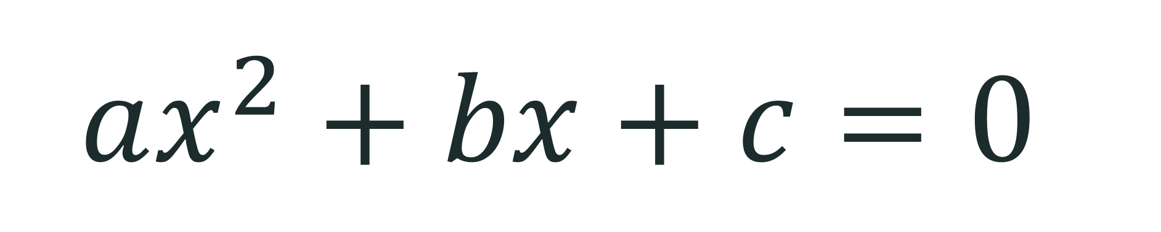
Derivation of Quadratic Formula
$$ax^{2}+bx+c=0$$

Slide 14
$$ax^{2}+bx+c=0$$

Slide 15
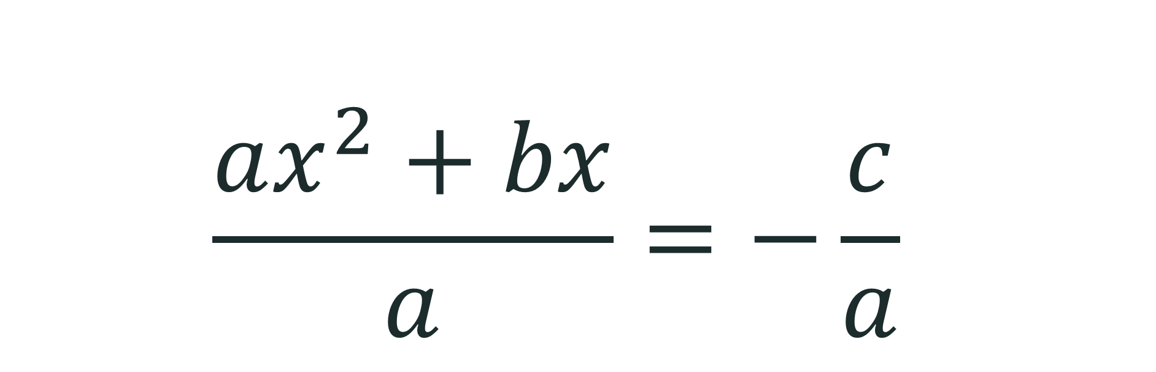


$$ax^{2}+bx+c=0$$
$$ax^{2}+bx=−c$$
$$\frac{ax^{2}+bx}{a}=−\frac{c}{a}$$

Slide 16

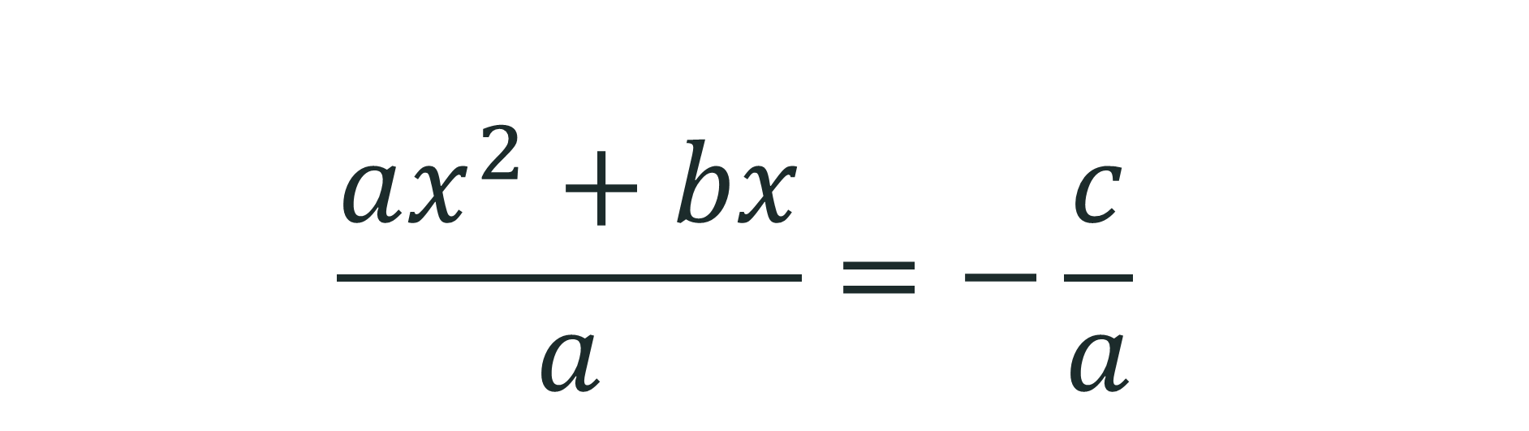


$$ax^{2}+bx+c=0$$
$$ax^{2}+bx=−c$$
$$\frac{ax^{2}+bx}{a}=−\frac{c}{a}$$
$$x^{2}+\frac{b}{a}x=−\frac{c}{a}$$

Slide 17

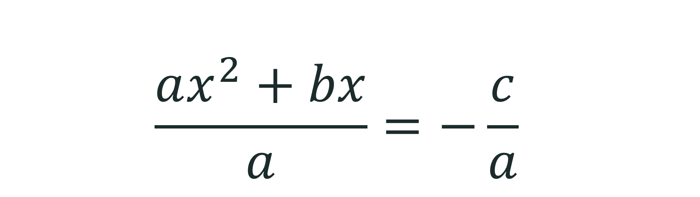


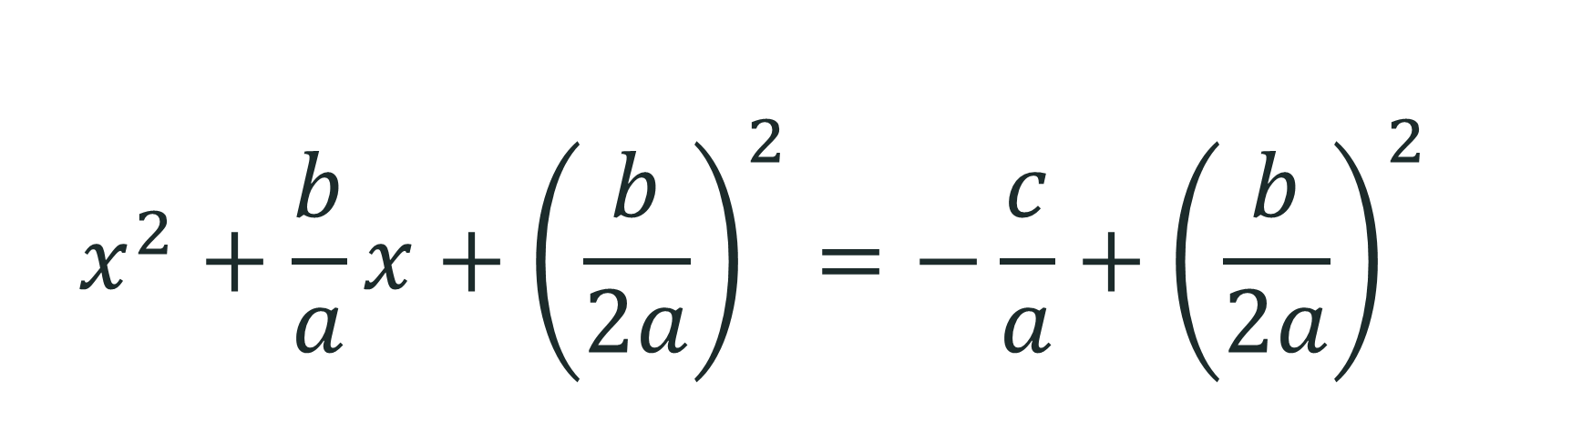
$$ax^{2}+bx+c=0$$
$$ax^{2}+bx=−c$$
$$\frac{ax^{2}+bx}{a}=−\frac{c}{a}$$
$$x^{2}+\frac{b}{a}x=−\frac{c}{a}$$
$$x^{2}+\frac{b}{a}x+{\left(\frac{b}{2a}\right)}^{2}=−\frac{c}{a}+{\left(\frac{b}{2a}\right)}^{2}$$

Slide 18
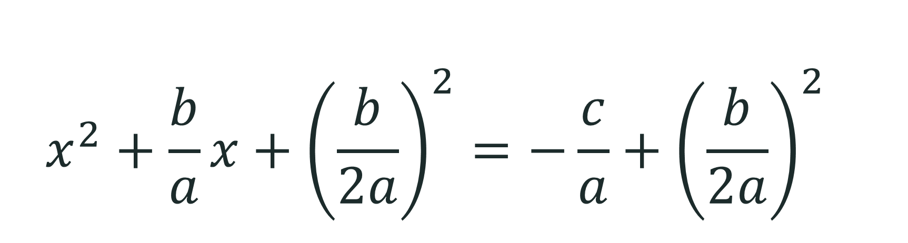

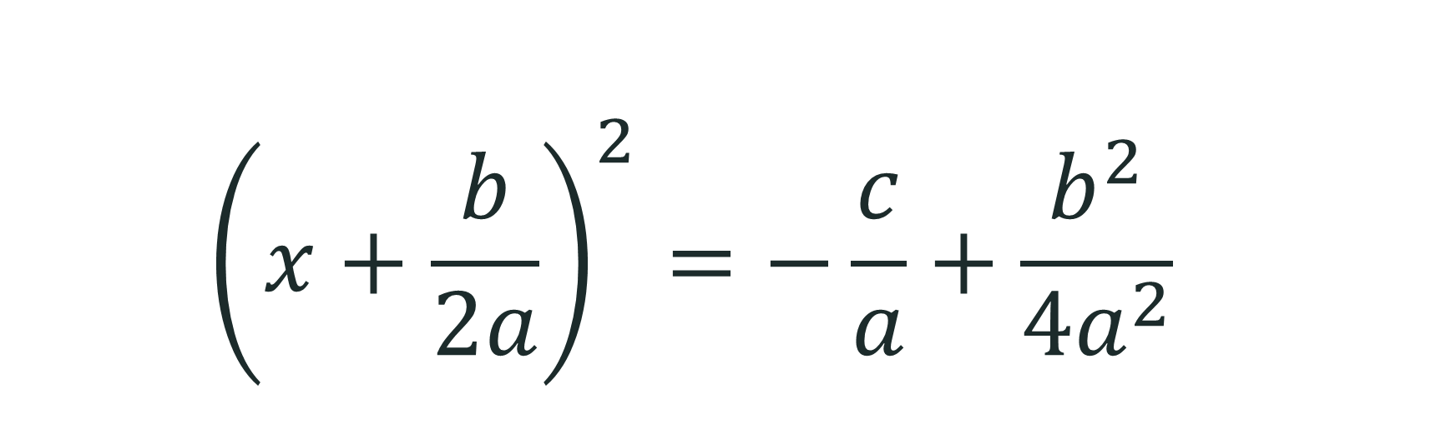
$$x^{2}+\frac{b}{a}x=−\frac{c}{a}$$
$$x^{2}+\frac{b}{a}x+{\left(\frac{b}{2a}\right)}^{2}=−\frac{c}{a}+{\left(\frac{b}{2a}\right)}^{2}$$
$${\left(x+\frac{b}{2a}\right)}^{2}=−\frac{c}{a}+\frac{b^{2}}{4a^{2}}$$

Slide 19
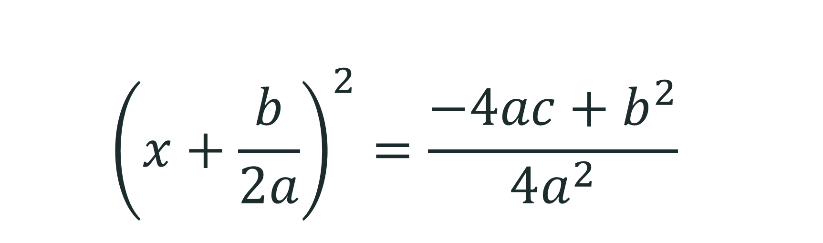

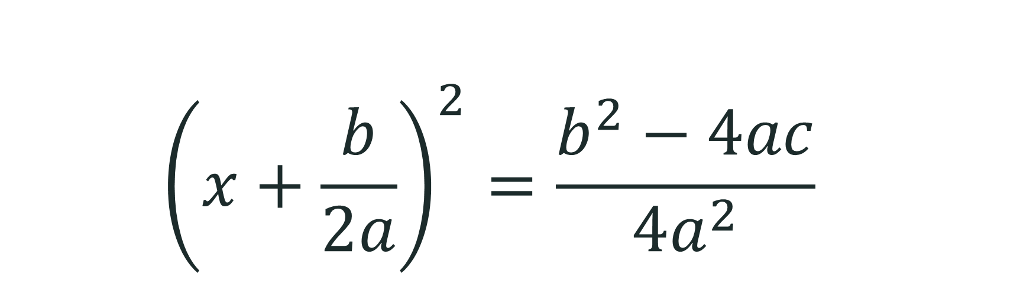
$$x^{2}+\frac{b}{a}x=−\frac{c}{a}$$
$$x^{2}+\frac{b}{a}x+{\left(\frac{b}{2a}\right)}^{2}=−\frac{c}{a}+{\left(\frac{b}{2a}\right)}^{2}$$
$${\left(x+\frac{b}{2a}\right)}^{2}=−\frac{c}{a}+\frac{b^{2}}{4a^{2}}$$
$${\left(x+\frac{b}{2a}\right)}^{2}=\frac{−4ac+b^{2}}{4a^{2}}$$
$${\left(x+\frac{b}{2a}\right)}^{2}=\frac{b^{2}−4ac}{4a^{2}}$$

Slide 20


$${\left(x+\frac{b}{2a}\right)}^{2}=\frac{b^{2}−4ac}{4a^{2}}$$
$$\sqrt{{\left(x+\frac{b}{2a}\right)}^{2}}=± \sqrt{\frac{b^{2}−4ac}{4a^{2}}}$$

Slide 21
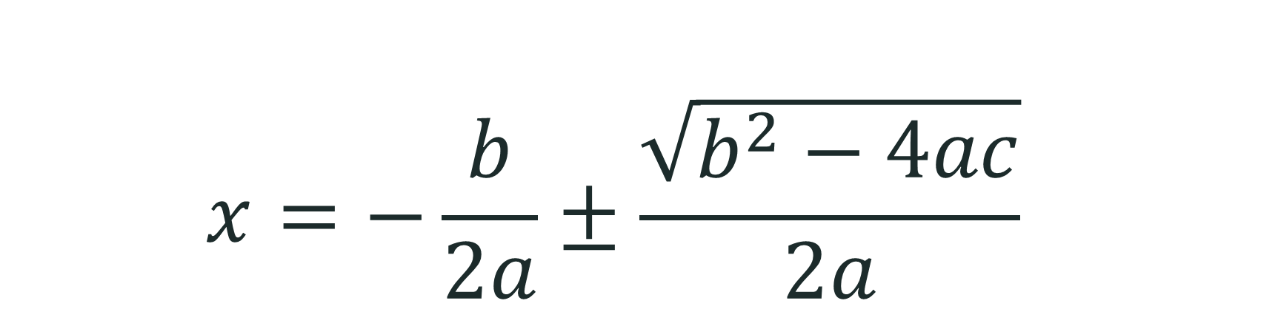
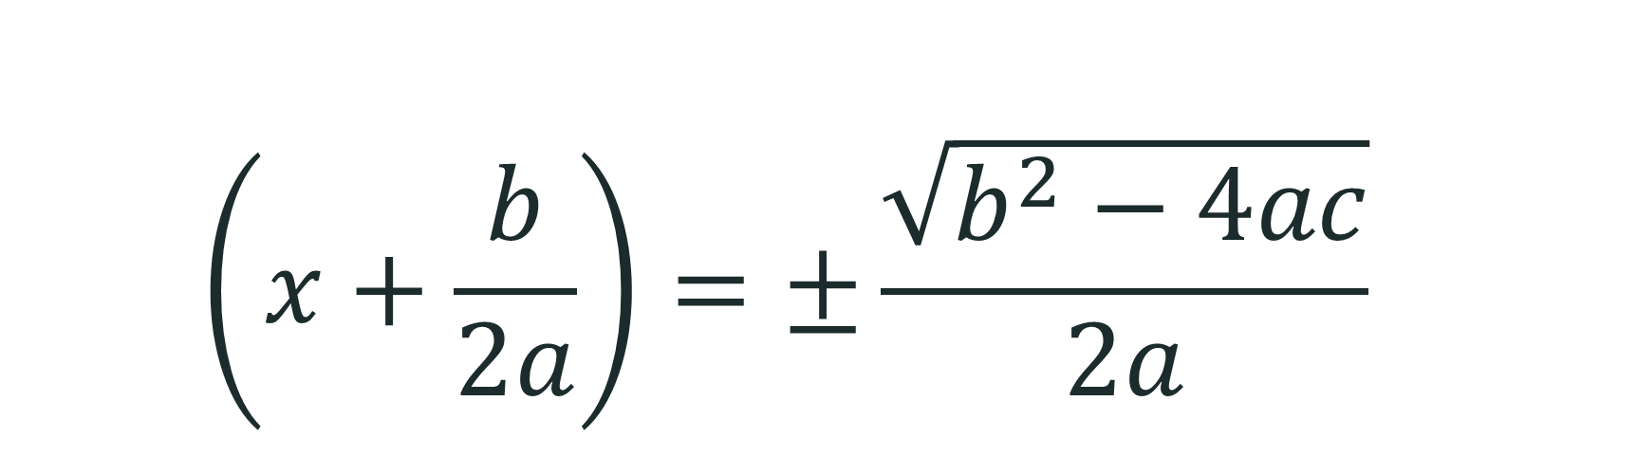

$${\left(x+\frac{b}{2a}\right)}^{2}=\frac{b^{2}−4ac}{4a^{2}}$$
$$\sqrt{{\left(x+\frac{b}{2a}\right)}^{2}}=± \sqrt{\frac{b^{2}−4ac}{4a^{2}}}$$
$$\left(x+\frac{b}{2a}\right)=±\frac{\sqrt{b^{2}−4ac}}{2a}$$
$$x=−\frac{b}{2a}±\frac{\sqrt{b^{2}−4ac}}{2a}$$

Slide 22
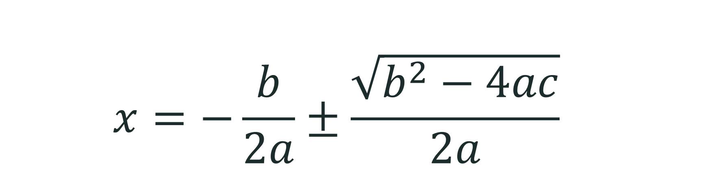
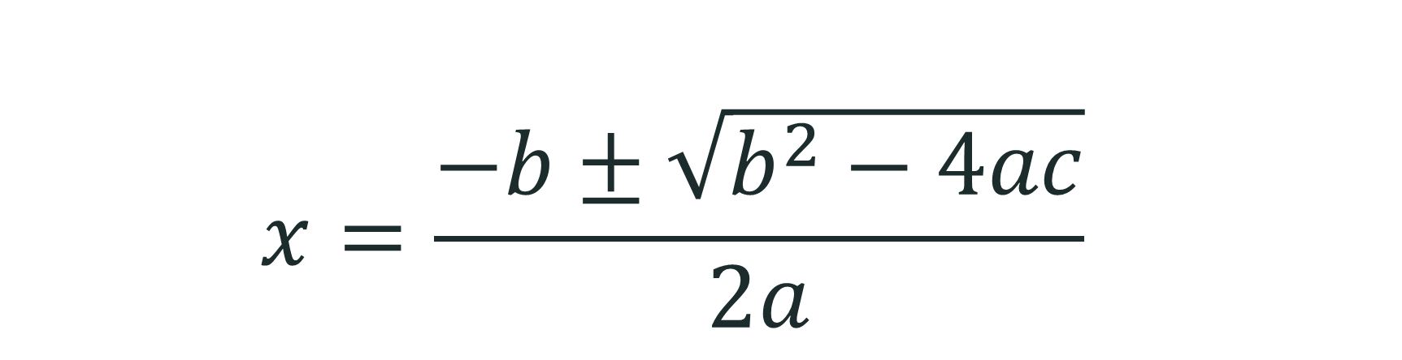
$${\left(x+\frac{b}{2a}\right)}^{2}=\frac{b^{2}−4ac}{4a^{2}}$$
$$\sqrt{{\left(x+\frac{b}{2a}\right)}^{2}}=± \sqrt{\frac{b^{2}−4ac}{4a^{2}}}$$
$$\left(x+\frac{b}{2a}\right)=±\frac{\sqrt{b^{2}−4ac}}{2a}$$
$$x=−\frac{b}{2a}±\frac{\sqrt{b^{2}−4ac}}{2a}$$
$$x=\frac{−b±\sqrt{b^{2}−4ac}}{2a}$$

Slide 23

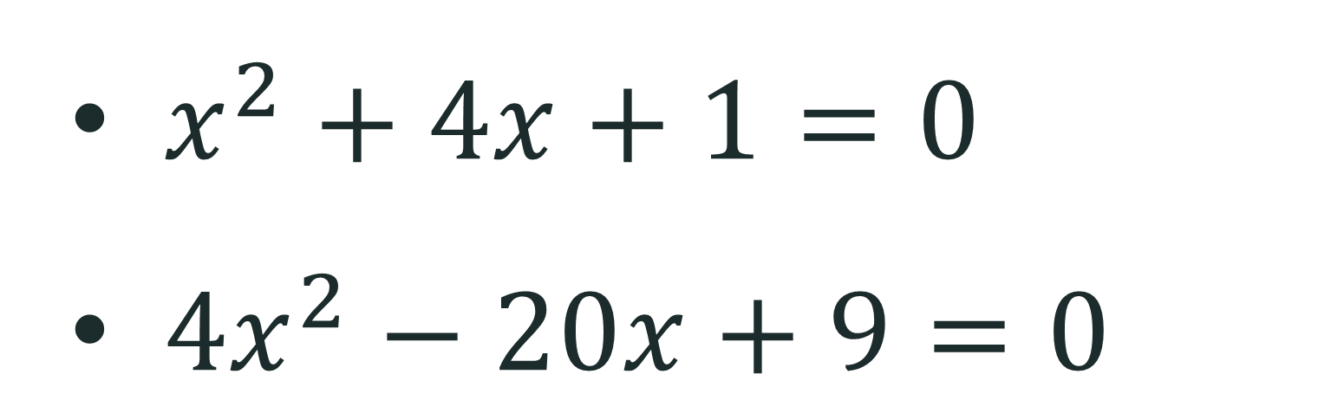
Quadratic Formula
In the quadratic equation, $ax^{2}+bx+c=0,$where $a≠0.$
$$x=\frac{−b±\sqrt{b^{2}−4ac} }{2a}$$

Slide 24

Let’s Try This!
Solve the quadratic equations using the quadratic formula.
$x^{2}+4x+1=0$
$x^{2}+8x−20=0$
$2x^{2}−3x−9=0$

Slide 25
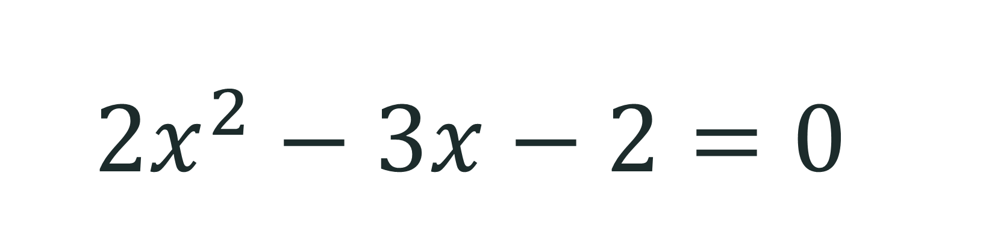
Your Turn!
Solve the quadratic equation using the quadratic formula.
$$2x^{2}−3x−2=0$$

Slide 26
Exit Ticket
Write the answer on your notebook.
One thing I learned about the quadratic formula is _____________________________.
One question I still have is ___________________.

Slide 27


Respect
Just as not all quadratic equations can be solved using the same method, not all people learn or solve problems in the same way. How can respecting different ways of thinking help you become a better classmate?

